Slide 1

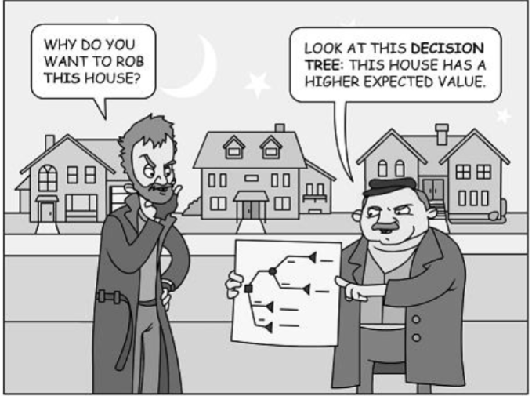
Clinical Decision Science: Informing Decision-Making Under Uncertainty
By: Paul Gerardo Yeh, MD, DrPH
3915 Course
November 2, 2023

Slide 2
Overview
Review of cost-effectiveness analysis
Decision analysis introduction
Framework for decision analysis
Decision Trees
Markov (cohort-based) models
Key concepts including health states, transition probabilities, half-cycle correction, discounting
Sensitivity analysis
Micro-simulation (individual-based) models
11/7: Clinical decision science as applied to cancer prevention/treatment examples:
Optimal (cost-effective) treatment of early-stage breast cancer for maximum survival and quality of life effect/benefits
Long-term impact of HPV vaccination on oral HPV infection and oropharyngeal cancer
CEA Overview
Decision Science Overview
Decision Analysis Framework
Decision Trees
Markov Cohort Models
Cohort Sensitivity Analysis
Microsimulation Models

Slide 3
CEA Overview (Review)
How much value for money invested will be received?
2 components (money & value)
How do we measure?
Money = net resources consumed in providing alternative ($)
Value = improvement in health outcomes (life-years, QALYs)
CEA Overview
Decision Science Overview
Decision Analysis Framework
Decision Trees
Markov Cohort Models
Cohort Sensitivity Analysis
Microsimulation Models

Slide 4
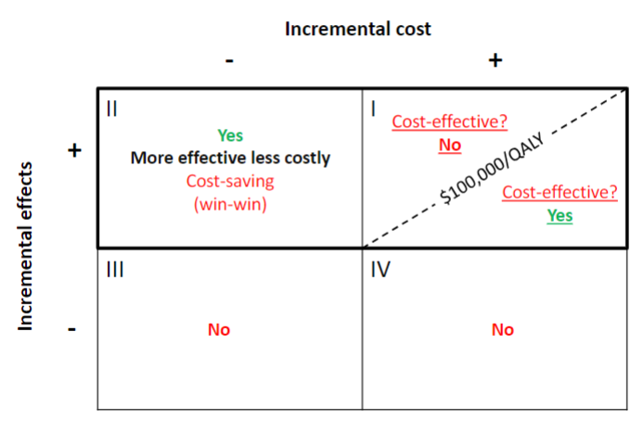
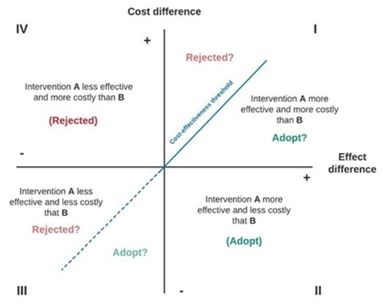
Cost-Effectiveness Analysis Schematic
CEA Overview
Decision Science Overview
Decision Analysis Framework
Decision Trees
Markov Cohort Models
Cohort Sensitivity Analysis
Microsimulation Models

Slide 5
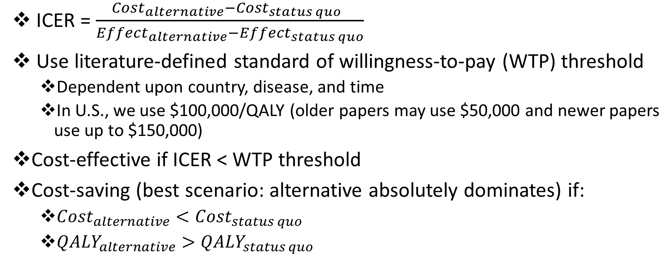
CEA Review Continued
ICER = $\frac{{Cost}_{alternative}−{Cost}_{status quo} }{{Effect}_{alternative}−{Effect}_{status quo}}$
Use literature-defined standard of willingness-to-pay (WTP) threshold
Dependent upon country, disease, and time
In U.S., we use $100,000/QALY (older papers may use $50,000 and newer papers use up to $150,000)
Cost-effective if ICER < WTP threshold
Cost-saving (best scenario: alternative absolutely dominates) if:
${Cost}_{alternative}<{Cost}_{status quo}$
${QALY}_{alternative}>{QALY}_{status quo}$
CEA Overview
Decision Science Overview
Decision Analysis Framework
Decision Trees
Markov Cohort Models
Cohort Sensitivity Analysis
Microsimulation Models

Slide 6
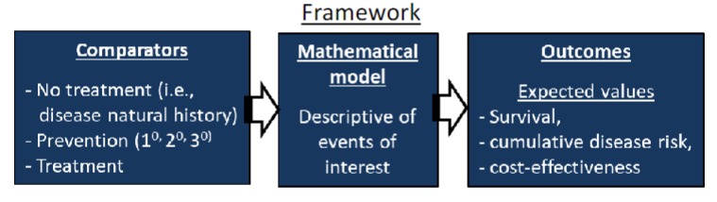
Clinical Decision Science
A quantitative method for evaluating decisions between multiple alternatives under conditions of uncertainty
Is this like real life?
Why use decision science analytics?
To project the future effects (and costs) of an intervention vs. status-quo
When it is unethical or impractical to run a clinical trial
CEA Overview
Decision Science Overview
Decision Analysis Framework
Decision Trees
Markov Cohort Models
Cohort Sensitivity Analysis
Microsimulation Models

Slide 7
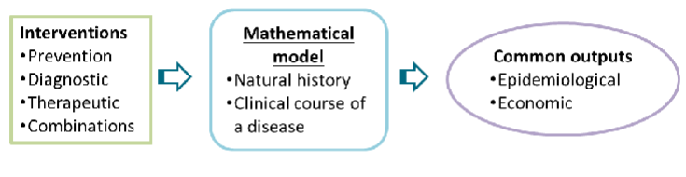
Decision Science Modeling
Mathematical model framework
Disease natural history: disease progression without intervention
Clinical course of disease: Disease prognosis and treatment outcomes after disease is initially diagnosed
Epidemiological outcomes: Disease prevalence, incidence, burden
Economic outcomes: Resource utilization for disease treatment, lifetime costs of treatment, cost-effectiveness, QALYs gained
7
CEA Overview
Decision Science Overview
Decision Analysis Framework
Decision Trees
Markov Cohort Models
Cohort Sensitivity Analysis
Microsimulation Models

Slide 8
Decision Analysis Framework
For decision analysis, you combine evidence for different parameters from different sources into one analytical model
Parameters:
Disease progression/risk (health state transition probabilities)
Treatment efficacy/effectiveness
Adverse side-effects of treatment, including death probability
Quality of life (health utilities) for different health states or outcomes
Costs (direct and indirect)
Sources for data:
Epidemiological studies on the natural history of disease
RCTs
Systematic reviews, pooled analyses, meta-analyses
Clinical trials
Observational studies
Pharmacological studies
Quality-of-life studies
Resource utilization studies
8
CEA Overview
Decision Science Overview
Decision Analysis Framework
Decision Trees
Markov Cohort Models
Cohort Sensitivity Analysis
Microsimulation Models

Slide 9
Decision Tree
Simplest form of decision model
Represents individuals’ possible prognoses (with or without intervention) by a series of pathways
Useful for short-term outcome estimates
9
CEA Overview
Decision Science Overview
Decision Analysis Framework
Decision Trees
Markov Cohort Models
Cohort Sensitivity Analysis
Microsimulation Models

Slide 10
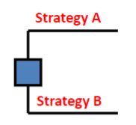
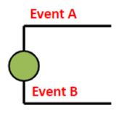
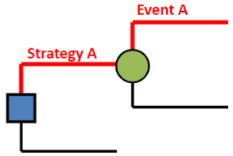
Decision Tree Features
Square decision node
Usually at start of tree
Indicates decision point between alternatives
Circular chance node
Point where after a decision is made, there are two or more alternative outcomes (events) possible
Represents uncertainty
Pathways
Mutually exclusive events that follow tree path linearly until its terminal node (outcome)
10
CEA Overview
Decision Science Overview
Decision Analysis Framework
Decision Trees
Markov Cohort Models
Cohort Sensitivity Analysis
Microsimulation Models

Slide 11
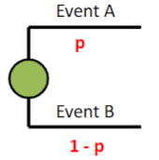
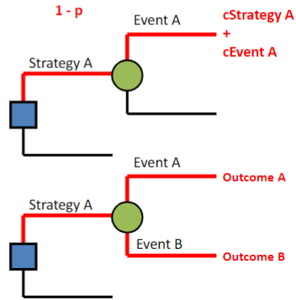
Decision Tree Features II
Branch probabilities
Likelihood of event occurring at a chance node
Pathway costs
Sum of costs of each event one patient experiences in a tree pathway
Outcomes
Each tree pathway ends with outcome at its terminal node
11
CEA Overview
Decision Science Overview
Decision Analysis Framework
Decision Trees
Markov Cohort Models
Cohort Sensitivity Analysis
Microsimulation Models

Slide 12
Building a Decision-Analytic Model
Define model structure
Assign probabilities associated for all events at each chance node
Assign utility values to all outcomes in the terminal nodes for each pathway
Evaluate expected values of each decision alternative
Conduct sensitivity analyses to account for uncertainty in analyses
12
CEA Overview
Decision Science Overview
Decision Analysis Framework
Decision Trees
Markov Cohort Models
Cohort Sensitivity Analysis
Microsimulation Models
12

Slide 13
Decision Tree: Application for a Clinical Question
Question: You have been asked to assess the cost-effectiveness of two proposed alternatives to routine practice in the follow-up of colorectal cancer survivors
What is our framework?
Specify the alternative strategies and outcomes
Status-quo comparator: routine care
Alternative 1: primary care-based follow-up approach
Alternative 2: hospital-based follow-up approach
Outcome for each strategy
Early detection of cancer recurrence
Late detection of cancer recurrence
13
CEA Overview
Decision Science Overview
Decision Analysis Framework
Decision Trees
Markov Cohort Models
Cohort Sensitivity Analysis
Microsimulation Models
13

Slide 14
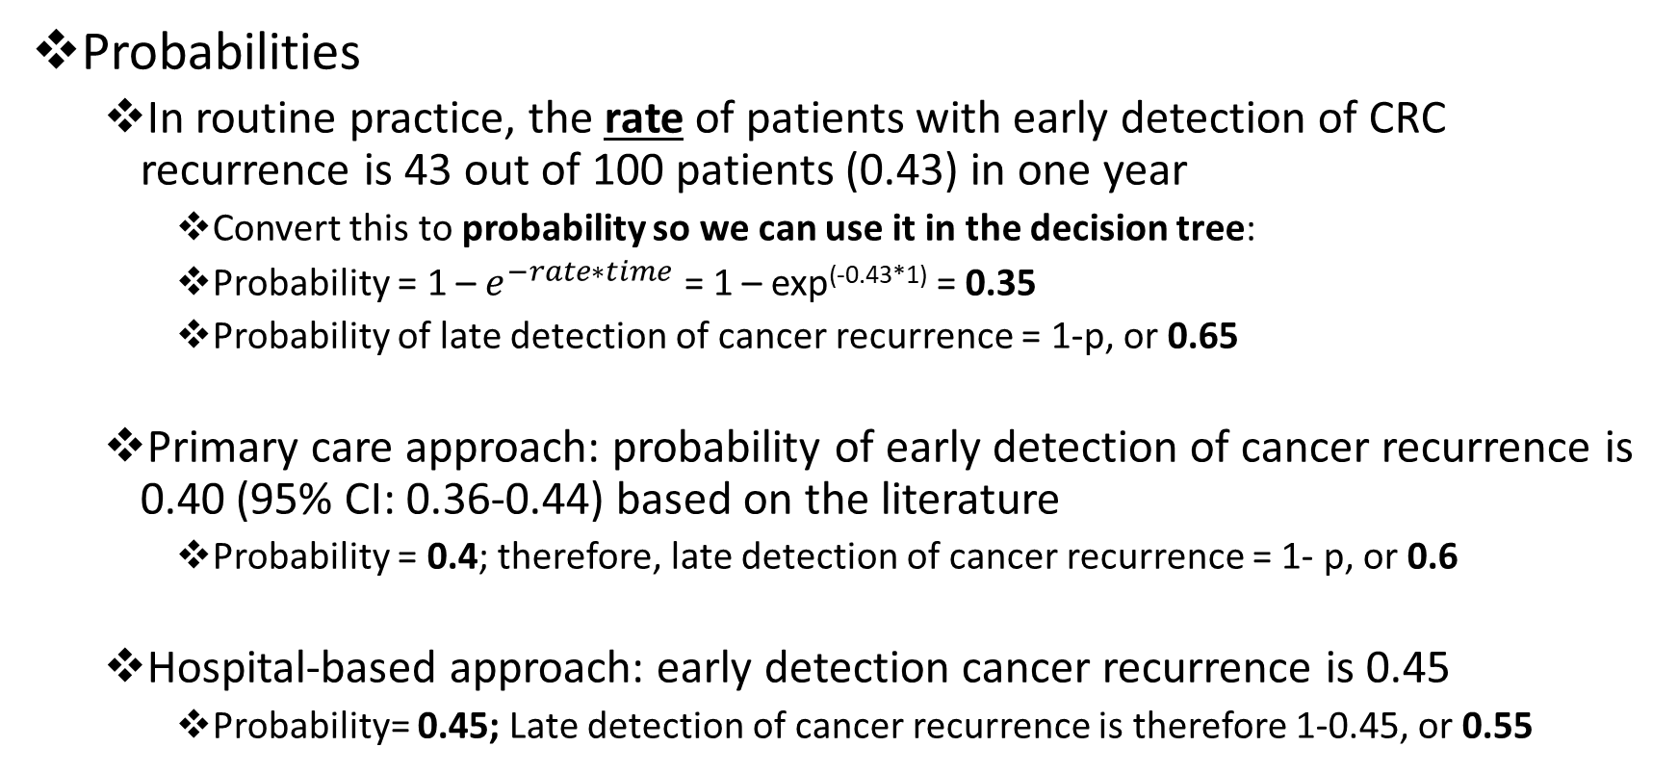
Forming a Model for Our Research Question
Probabilities
In routine practice, the rate of patients with early detection of CRC recurrence is 43 out of 100 patients (0.43) in one year
Convert this to probability so we can use it in the decision tree:
Probability = 1 – $e^{−rate∗time}$ = 1 – exp^{(-0.43*1)} = 0.35
Probability of late detection of cancer recurrence = 1-p, or 0.65
Primary care approach: probability of early detection of cancer recurrence is 0.40 (95% CI: 0.36-0.44) based on the literature
Probability = 0.4; therefore, late detection of cancer recurrence = 1- p, or 0.6
Hospital-based approach: early detection cancer recurrence is 0.45
Probability= 0.45; Late detection of cancer recurrence is therefore 1-0.45, or 0.55
14
CEA Overview
Decision Science Overview
Decision Analysis Framework
Decision Trees
Markov Cohort Models
Cohort Sensitivity Analysis
Microsimulation Models
14

Slide 15
Model Parameters From Literature: Cost and Effectiveness of Each Tree Pathway
Tree pathway cost per year | Tree pathway cost per year
Routine practice
Early detection | $3,030
Late detection | $12,020
Primary care based approach
Early detection | $3,900
Late detection | $12,800
Hospital based approach
Early detection | $6,200
Late detection | $14,400
Effectiveness (life expectancy) | Effectiveness (life expectancy)
Early detection of cancer recurrence | 7 years
Late detection of cancer recurrence | 1.5 years
15
CEA Overview
Decision Science Overview
Decision Analysis Framework
Decision Trees
Markov Cohort Models
Cohort Sensitivity Analysis
Microsimulation Models
15

Slide 16
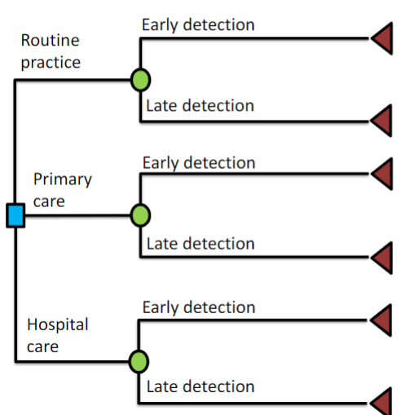
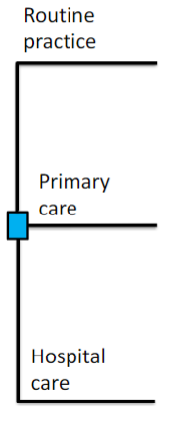
Designing the Decision Tree
What about the chance node?
The two outcomes
Initial decision node is what?
The three strategies
16
CEA Overview
Decision Science Overview
Decision Analysis Framework
Decision Trees
Markov Cohort Models
Cohort Sensitivity Analysis
Microsimulation Models
16

Slide 17
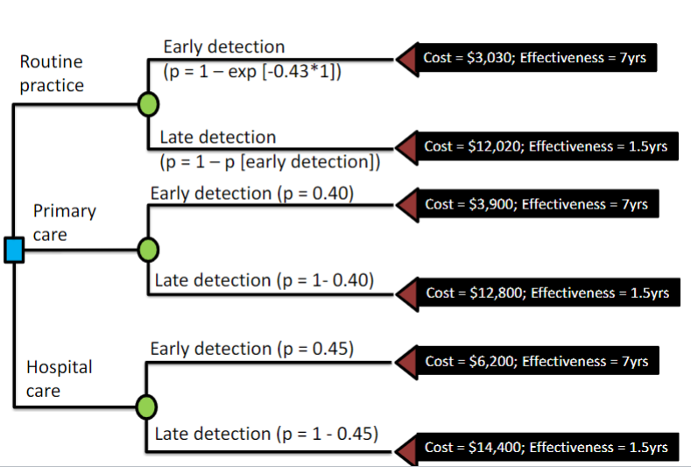
Decision Tree Model: Add Probability, Cost, and Effectiveness Parameters
17
CEA Overview
Decision Science Overview
Decision Analysis Framework
Decision Trees
Markov Cohort Models
Cohort Sensitivity Analysis
Microsimulation Models
17

Slide 18
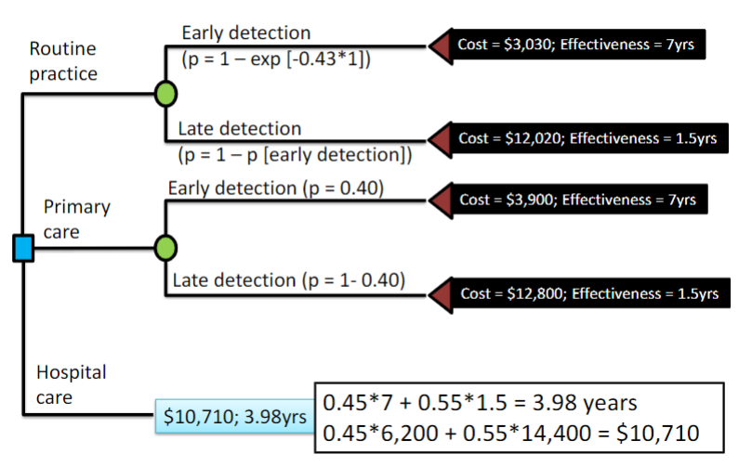
Decision Tree: Average Roll-Back Analysis
Overall effect = (probability of early * early effect) + (probability of late * late effect)
Overall cost = (probability of early * early cost) + (probability of late * late cost)
18
CEA Overview
Decision Science Overview
Decision Analysis Framework
Decision Trees
Markov Cohort Models
Cohort Sensitivity Analysis
Microsimulation Models
18

Slide 19
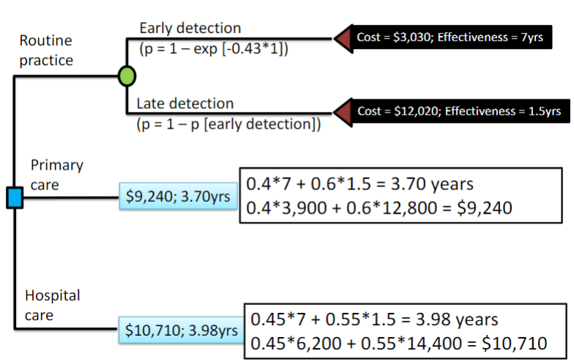
Decision Tree: Average Roll-Back Analysis
19
CEA Overview
Decision Science Overview
Decision Analysis Framework
Decision Trees
Markov Cohort Models
Cohort Sensitivity Analysis
Microsimulation Models
19

Slide 20
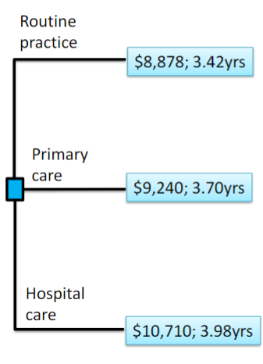
Decision Tree: Calculate ICER for Cost-Effectiveness Analysis
Strategy | Incr Cost | Incr Effect (life-year gained) | ICER ($/life-year gained)
Routine practice | --- | --- | ---
Primary care | $362 | 0.28 | $1,293
Hospital care | $1,470 | 0.28 | $5,250
20
CEA Overview
Decision Science Overview
Decision Analysis Framework
Decision Trees
Markov Cohort Models
Cohort Sensitivity Analysis
Microsimulation Models
20

Slide 21
Decision Tree Analysis Limitations
Time is not explicitly defined
Complexity increases exponentially for longer-term prognoses or outcomes
What if we modeled long-term outcomes related to diabetes comorbidities?
We have potential for retinopathy, nephropathy, cardiometabolic, neurological disease, in addition to death
21
CEA Overview
Decision Science Overview
Decision Analysis Framework
Decision Trees
Markov Cohort Models
Cohort Sensitivity Analysis
Microsimulation Models
21

Slide 22
Markov State-Transition Cohort Models
Markov models are repetitive decision trees
Based on series of “health states” a patient can occupy at any time point
Health states: mutually exclusive and collectively exhaustive clinical events/states that can occur to a patient
A person can only be in one health state
All health states for a particular chance node represent all possibilities of prognosis for a person
Time elapses
“Probability” of patient occupying health states is assessed over series of time periods (cycles)
Transition probability: probability of transitioning from one health state to another
22
CEA Overview
Decision Science Overview
Decision Analysis Framework
Decision Trees
Markov Cohort Models
Cohort Sensitivity Analysis
Microsimulation Models
22

Slide 23
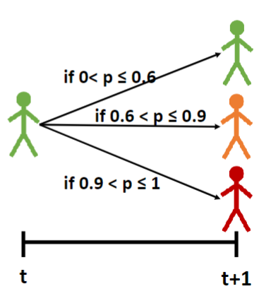
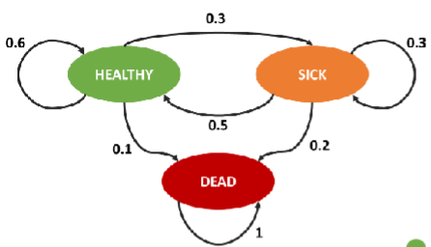
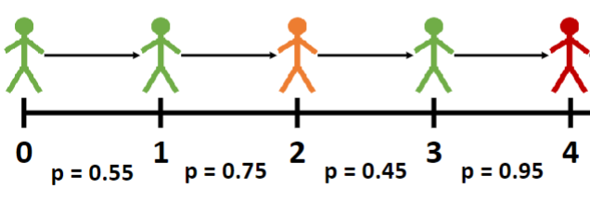
23
CEA Overview
Decision Science Overview
Decision Analysis Framework
Decision Trees
Markov Cohort Models
Cohort Sensitivity Analysis
Microsimulation Models
23

Slide 24
Markov Cohort Model Analysis Example: Framework
A cost-effectiveness analysis of zidovudine monotherapy compared with zidovudine plus lamivudine combination therapy (Chancellor et al., 1997)
Population of interest: Patients with HIV infection
Baseline cohort: HIV patients with CD4 count>500
Outcome of interest: ICER of incremental cost/life-year gained
24
CEA Overview
Decision Science Overview
Decision Analysis Framework
Decision Trees
Markov Cohort Models
Cohort Sensitivity Analysis
Microsimulation Models
24

Slide 25
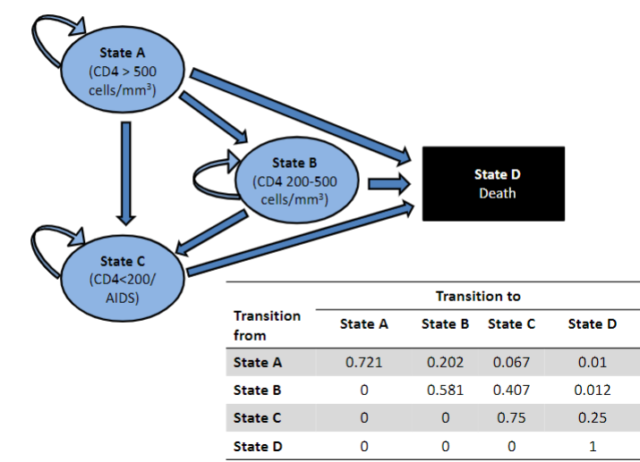
Example Markov Cohort Analysis II: Model
25
CEA Overview
Decision Science Overview
Decision Analysis Framework
Decision Trees
Markov Cohort Models
Cohort Sensitivity Analysis
Microsimulation Models
25

Slide 26
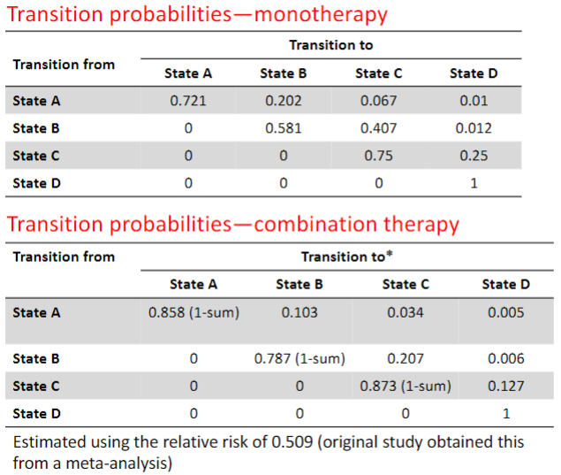
Example Markov Cohort Analysis III: Probabilities
Combination therapy has a RR of 0.509 (derived from meta-analysis)
Therefore, health state transition in monotherapy from state A to B, C, and D can be multiplied by 0.509 for combination therapy
Staying in one health state (e.g., State A to State A) is always 1-sum of the probabilities of transitioning to all other states
26
CEA Overview
Decision Science Overview
Decision Analysis Framework
Decision Trees
Markov Cohort Models
Cohort Sensitivity Analysis
Microsimulation Models
26

Slide 27
Example Markov Cohort Analysis IV: Costs
 | Annual Healthcare Cost
Zidovudine | $2,278
Lamivudine | $2,086
Health states | State A (CD4>500) | State B (CD4 200-500) | State C (AIDS, CD4 <200) | State D (death)
Direct medical | $1,701 | $1,774 | $6,948
Community | $1,055 | $1,278 | $2,059
Total costs | $2,756 | $3,052 | $9,007 | $0
27
CEA Overview
Decision Science Overview
Decision Analysis Framework
Decision Trees
Markov Cohort Models
Cohort Sensitivity Analysis
Microsimulation Models
27

Slide 28
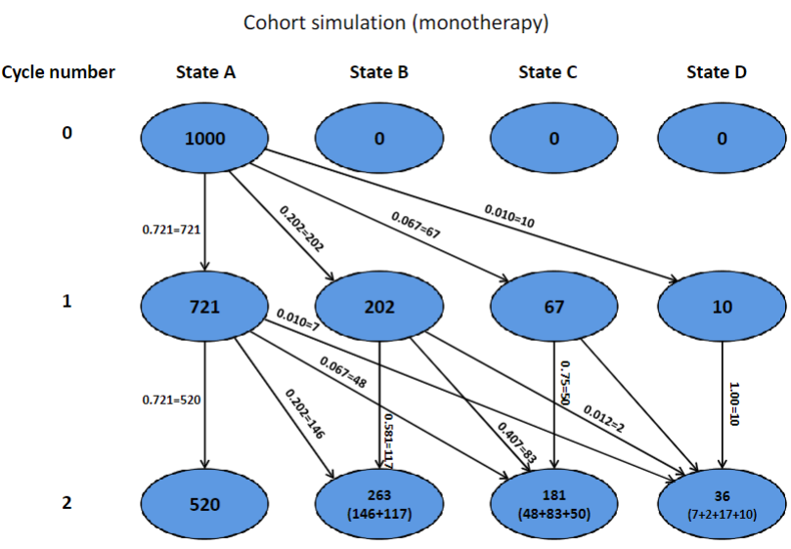
Example Markov Cohort Analysis V: Cohort simulation (monotherapy)
28
CEA Overview
Decision Science Overview
Decision Analysis Framework
Decision Trees
Markov Cohort Models
Cohort Sensitivity Analysis
Microsimulation Models
28

Slide 29
Example Markov Cohort Analysis VI: Cohort simulation (monotherapy)
We can manually calculate expected costs PER cycle (year) of simulation with monotherapy:
Note: we may apply 3-6% discounting per year to convert future dollar and health outcomes to their NET PRESENT VALUE TODAY
Expected cost = (721(2756+2278) + 202(3052+2278) + 67(9007+2278))/1000
Discounted cost = 5463/[(1+0.06)¹]
Cycle (year) | Proportion of cohort in each state |  |  |  | Costs ($)
 | A | B | C | D | Undiscounted | Discounted
0 | 1000 | 0 | 0 | 0
1 | 721 | 202 | 67 | 10 | 5463 | 5153
29
CEA Overview
Decision Science Overview
Decision Analysis Framework
Decision Trees
Markov Cohort Models
Cohort Sensitivity Analysis
Microsimulation Models
29

Slide 30
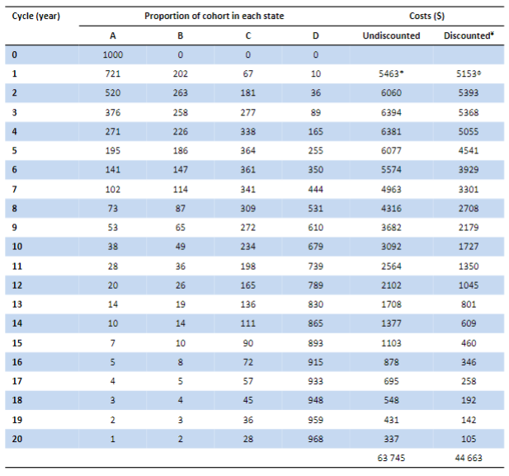
Example Markov Cohort Analysis VII: Cohort simulation (monotherapy)
30
CEA Overview
Decision Science Overview
Decision Analysis Framework
Decision Trees
Markov Cohort Models
Cohort Sensitivity Analysis
Microsimulation Models
30

Slide 31
Example Markov Cohort Analysis VIII: Cohort simulation (monotherapy) half-cycle correction
We apply half-cycle correction to assume mean average state transition occurs in the exact middle of a cycle
Cycle (year) | Proportion of cohort in each state |  |  |  | Effect (survival probability)
 | A | B | C | D | All transitions occur at beginning of cycle | Mean transition occur at middle of cycle
0 | 1000 | 0 | 0 | 0
1 | 721 | 202 | 67 | 10 | (721+202+67)/1000 = 0.990 | (721+202+67+(0.5*10))/1000 = 0.995
31
CEA Overview
Decision Science Overview
Decision Analysis Framework
Decision Trees
Markov Cohort Models
Cohort Sensitivity Analysis
Microsimulation Models
31

Slide 32
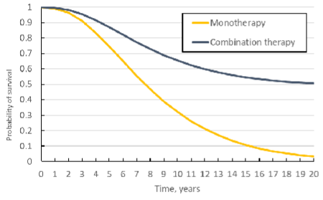
Example Markov Cohort Analysis IX: Cohort simulation (monotherapy vs. combination)
Strategy | Incr Cost | Incr Effect (life-year gained) | ICER ($/life-year saved)
Monotherapy | --- | --- | ---
Primary care | $35,170 | 5.90 | $5,976
32
CEA Overview
Decision Science Overview
Decision Analysis Framework
Decision Trees
Markov Cohort Models
Cohort Sensitivity Analysis
Microsimulation Models
32

Slide 33
Markov Model Sensitivity Analysis & Limitations
Account for parametric uncertainty
For example, in Chancellor et al., 1997 paper, the relative risk of progression due to combination therapy was 0.509 (95% CI: 0.365-0.710)
We can run the analysis seeing how varying each parameter value impacts ICER (one-way sensitivity analysis → form Tornado diagram)
Can visualize which parameters have the largest impact on ICER
We can also run analysis seeing how MULTIPLE parameter value changing at the same time can impact ICER (two-way or three-way sensitivity analysis)
Markov model is “memoryless”- once a patient transitions, the Markov model has no memory regarding the patient’s prior disease history or their preceding health states
Is this realistic?
33
CEA Overview
Decision Science Overview
Decision Analysis Framework
Decision Trees
Markov Cohort Models
Cohort Sensitivity Analysis
Microsimulation Models

Slide 34
Microsimulation (Individual-level) simulation modeling
More realistic
Markov models may make assumptions that are not realistic
Individual patient moves from one health state to another based on their baseline demographics/risk factors
Allows for individual-level complexity to be captured using “tracker” variables in the model
34
CEA Overview
Decision Science Overview
Decision Analysis Framework
Decision Trees
Markov Cohort Models
Cohort Sensitivity Analysis
Microsimulation Models

Slide 35
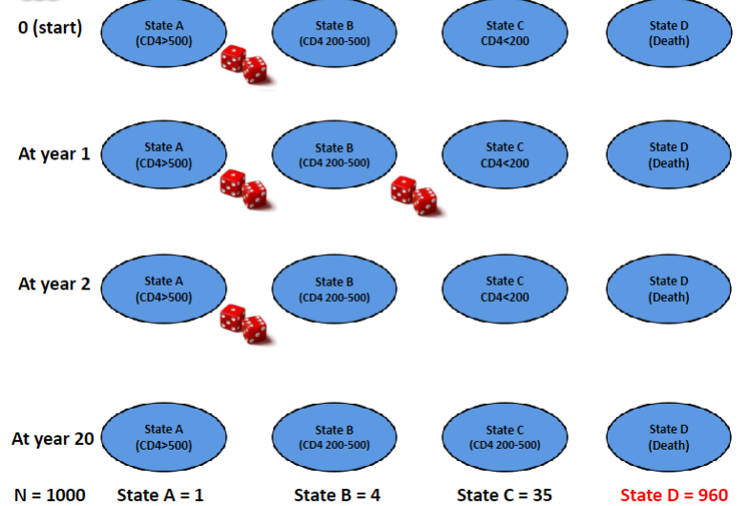
35
CEA Overview
Decision Science Overview
Decision Analysis Framework
Decision Trees
Markov Cohort Models
Cohort Sensitivity Analysis
Microsimulation Models

Slide 36
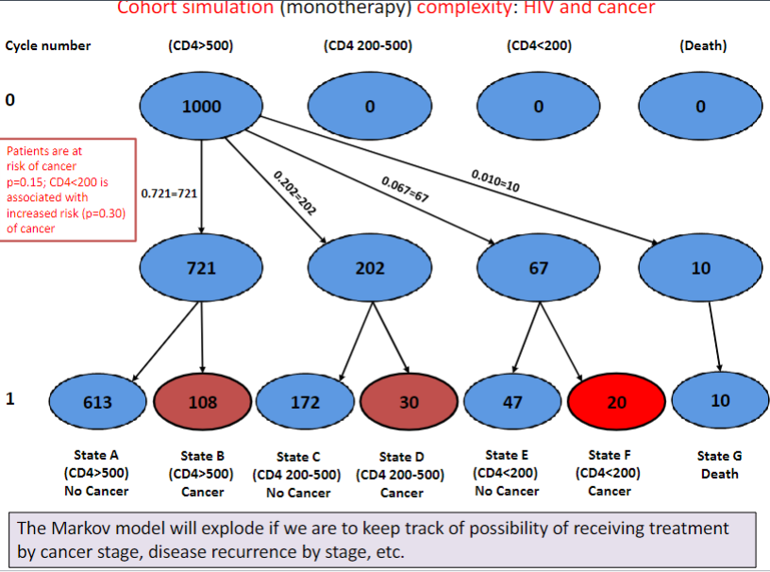
36
CEA Overview
Decision Science Overview
Decision Analysis Framework
Decision Trees
Markov Cohort Models
Cohort Sensitivity Analysis
Microsimulation Models

Slide 37
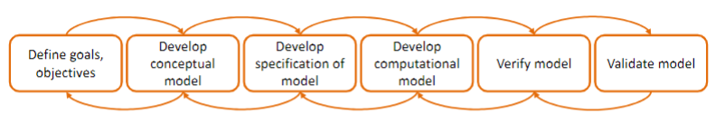
Decision Analytic Modeling
Determine what is your ultimate goal for the model?
The model is a PLATFORM for you to achieve your goal
Goals can change with increasing insight
Conceptual model: determine your alternatives, health states, outcomes
Collect data (e.g. literature) from populate model
Develop simulation model using Excel, Treeage, etc.
Ensure that model results make sense. Computation = specification model
Compare results to another model or population data, other models
37
CEA Overview
Decision Science Overview
Decision Analysis Framework
Decision Trees
Markov Cohort Models
Cohort Sensitivity Analysis
Microsimulation Models

